Slide 1
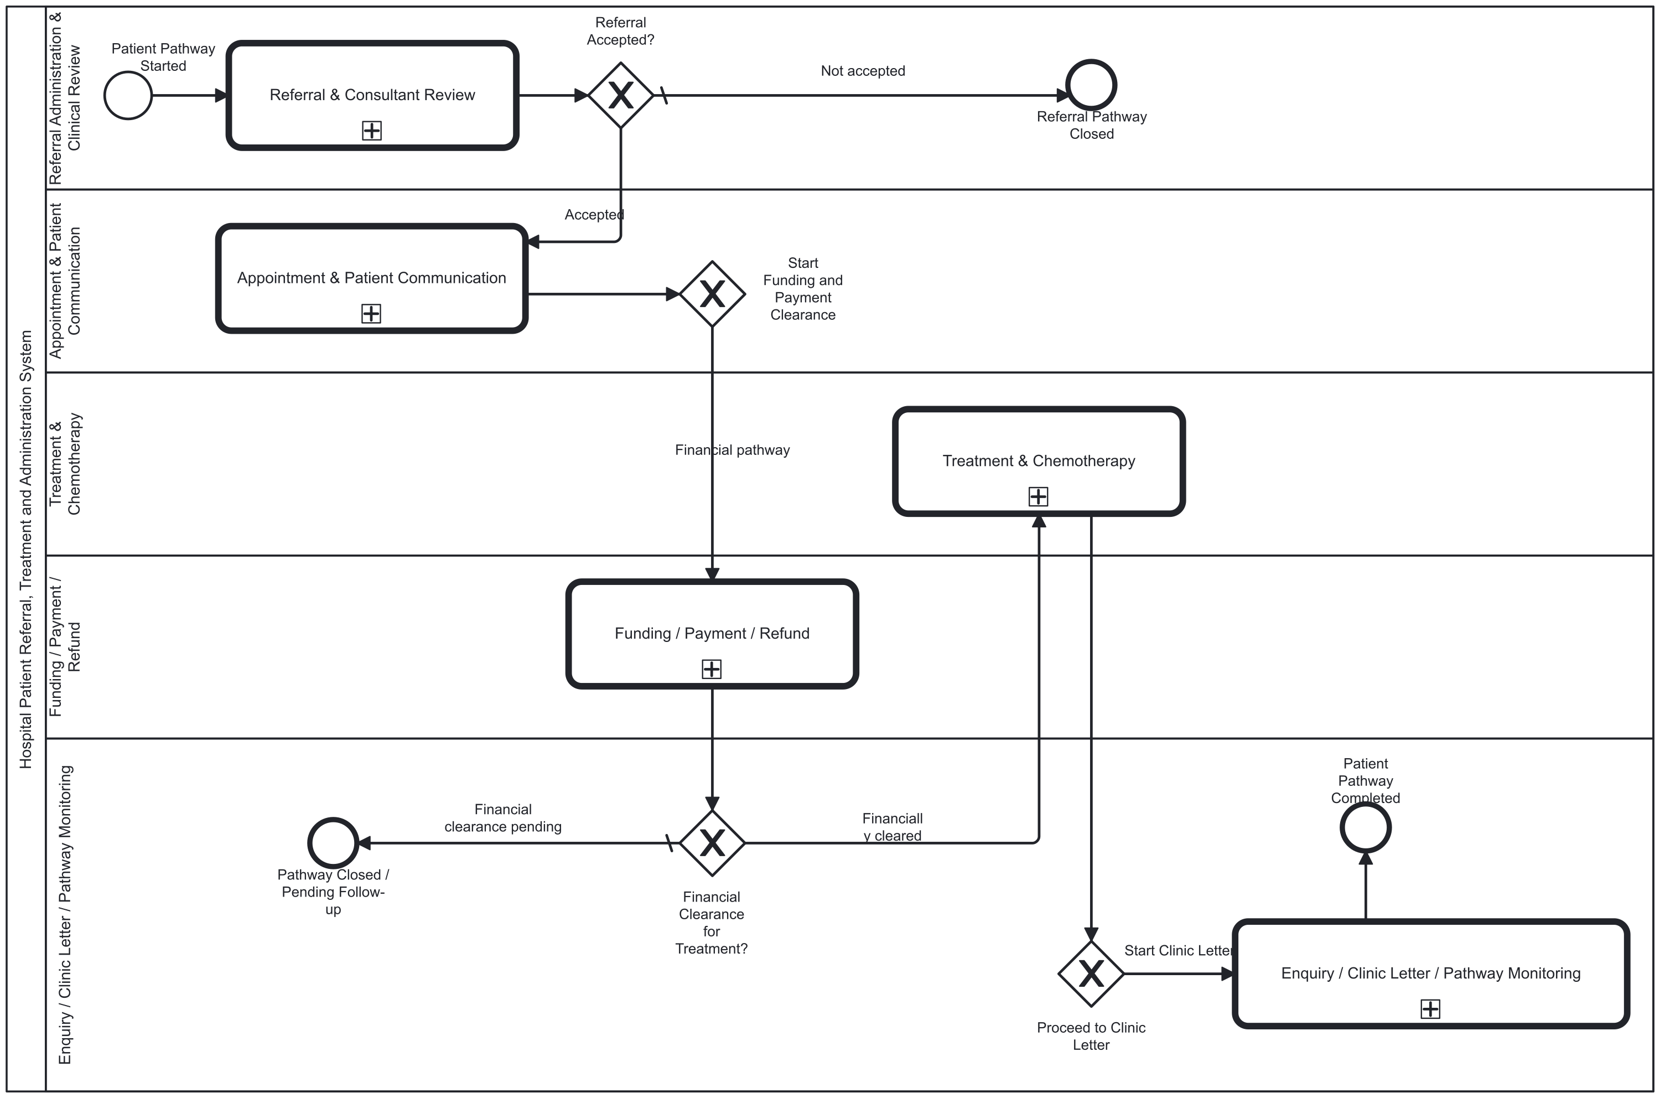
Operational BPMN: integrated patient pathway
GROUP / 01
Notes:
Presenter: GROUP
中文讲解与可能追问
这是当前可执行的主流程。它调用五个子流程，按转诊、预约、财务、治疗、信件顺序交接。只有 referralDecision=ACCEPT 才进入预约。财务结果由 fundingType、fundingApproved、paymentStatus 与 urgentTreatmentOverride 判断。治疗子流程无论同意与否结束后都会调用信件。可能追问：为什么财务在治疗前？因为常规治疗需要清算前提；但当前治疗子流程才做临床评估，这个顺序仍需业务复核。咨询和退款有独立消息启动，非普通主线。
Sources
D:\Camunda-Workspace\models\assignment\bpmn\Hospital_Master_Process.bpmn
Acceptance criteria are pass/fail targets. This deck does not claim that every criterion has passed in the final Camunda deployment.

Slide 2
Integrated pathway: measurable acceptance criteria
ID | Given / when | Measurable pass condition
M1 | Referral outcome = ACCEPT / REJECT / REDIRECT | ACCEPT: appointment child entered once. REJECT and REDIRECT: appointment child entered 0 times.
M2 | Funding is HOSPITAL, EXEMPTION, approved INSURER, or successful PATIENT payment | Each cleared case enters treatment once; unapproved insurer or unsuccessful patient payment without override enters treatment 0 times.
M3 | Treatment child ends, including patientConsent = false | Clinic-letter child starts once for each completed treatment child.
M4 | One complete normal instance | Five called stages follow the expected order, the final end is reached, and engine incidents = 0.
GROUP / 02
Notes:
Presenter: GROUP
中文讲解与可能追问
逐行按实例路径验收，不把模型静态配置当作运行结果。M1 看主流程调用活动次数，M2 看财务网关的分支，M3 看无治疗仍进入信件，M4 保存主实例号、子实例号、版本、结束时间与 incident 数。当前没有一条最新版本主流程的完整运行证据，M4 是待实测的标准。
Sources
D:\Camunda-Workspace\models\assignment\bpmn\Hospital_Master_Process.bpmn
Acceptance criteria are pass/fail targets. This deck does not claim that every criterion has passed in the final Camunda deployment.

Slide 3
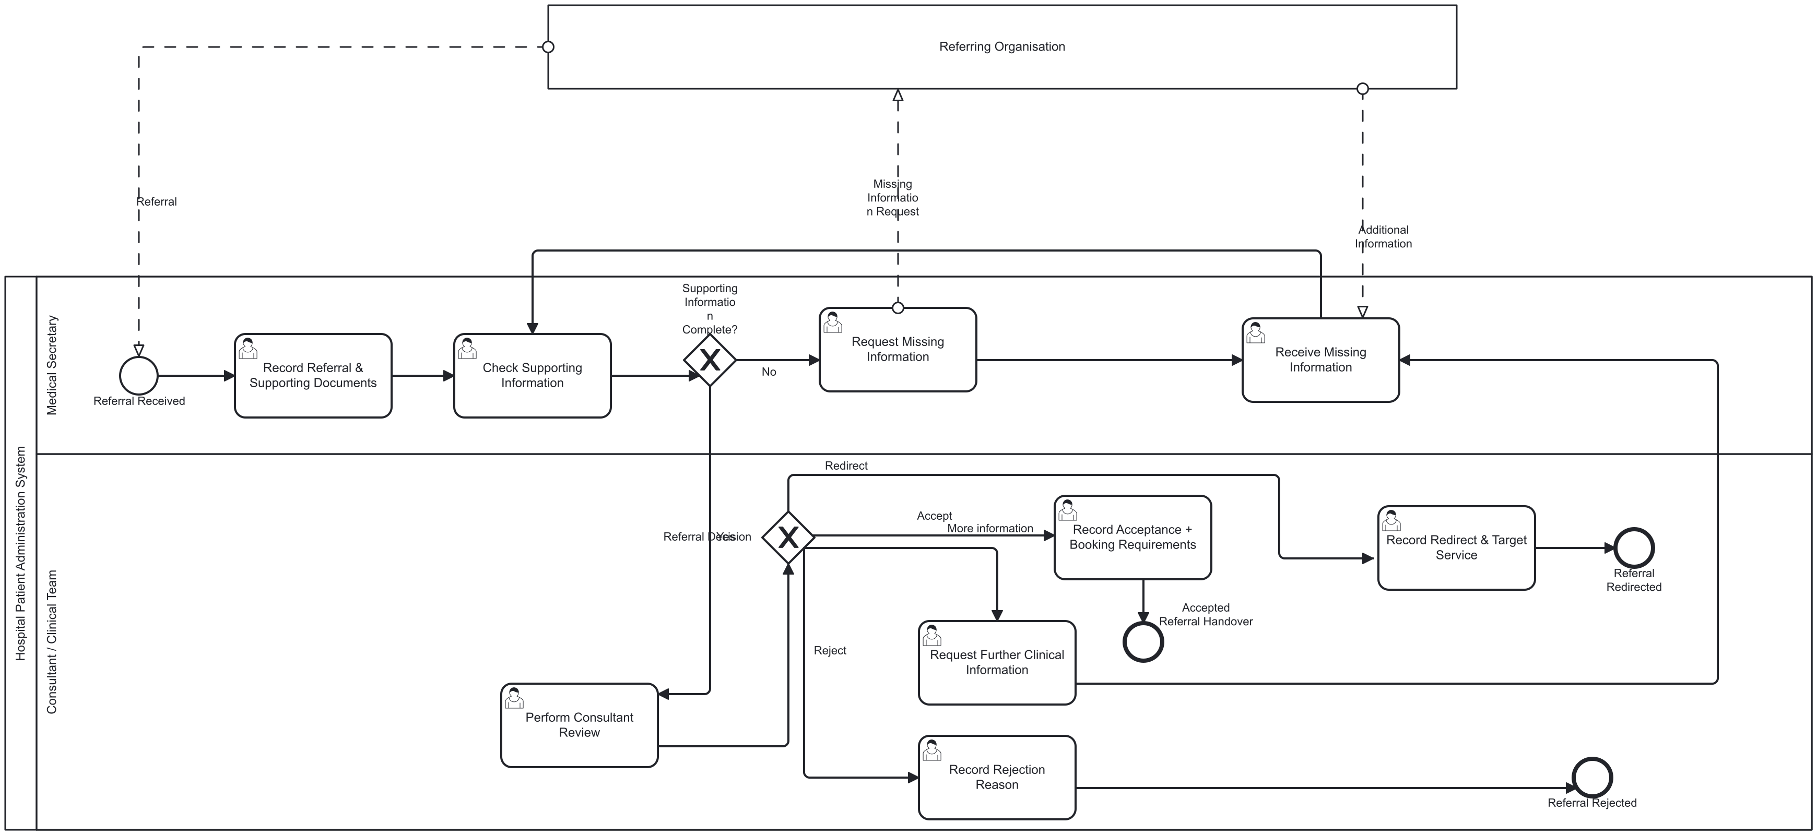
Operational BPMN: referral and consultant review
DENG JIN WANG / 03
Notes:
Presenter: DENG JIN WANG
中文讲解与可能追问
讲图从转诊接收开始。秘书填写患者、转诊和转诊机构信息，informationComplete=false 时请求补充，true 时进入顾问审核。顾问从 ACCEPT、REJECT、MORE_INFORMATION、REDIRECT 四种选择中决定。只有 ACCEPT 交给预约。可能追问：为什么没有 worker？此处没有外部 service task，依赖人工任务；外部组织的消息线表达协作，不等于已实现消息接口。
Sources
D:\Camunda-Workspace\models\assignment\bpmn\23084366_Referral_Consultant_Review\BPMN\Referral_Consultant_Review.bpmn
D:\Camunda-Workspace\models\assignment\bpmn\23084366_Referral_Consultant_Review\Forms\Form_ReferralIntake.form
D:\Camunda-Workspace\models\assignment\bpmn\23084366_Referral_Consultant_Review\Forms\Form_ConsultantReview.form
Acceptance criteria are pass/fail targets. This deck does not claim that every criterion has passed in the final Camunda deployment.

Slide 4
Referral: measurable acceptance criteria
ID | Given / when | Measurable pass condition
R1 | Intake lacks patientId, referralId or referringOrganisation | Submission is blocked for each missing required field (3/3 checks).
R2 | informationComplete = false, then corrected to true | Before correction: consultant review reached 0 times and missing-information task reached at least once. After correction: consultant review reached once.
R3 | Set each of the four consultant decision values | ACCEPT reaches accepted handover; REJECT and REDIRECT reach their own end; MORE_INFORMATION returns to intake. Correct routes: 4/4.
R4 | Decision is REJECT or REDIRECT in the master | Appointment child starts 0 times in both cases.
DENG JIN WANG / 04
Notes:
Presenter: DENG JIN WANG
中文讲解与可能追问
两个表单分别处理转诊录入和顾问决定。顾问表单要求 patientId、referralDecision、referralDecisionReason。R1 使用表单必填校验；R2 和 R3 用引擎路径与实例变量判断；R4 要从主实例验证交接，而不仅看子流程结尾。已见历史 ACCEPT 路径，另外三种决定仍需各自的运行记录。
Sources
D:\Camunda-Workspace\models\assignment\bpmn\23084366_Referral_Consultant_Review\BPMN\Referral_Consultant_Review.bpmn
D:\Camunda-Workspace\models\assignment\bpmn\23084366_Referral_Consultant_Review\Forms\Form_ReferralIntake.form
D:\Camunda-Workspace\models\assignment\bpmn\23084366_Referral_Consultant_Review\Forms\Form_ConsultantReview.form
Acceptance criteria are pass/fail targets. This deck does not claim that every criterion has passed in the final Camunda deployment.

Slide 5
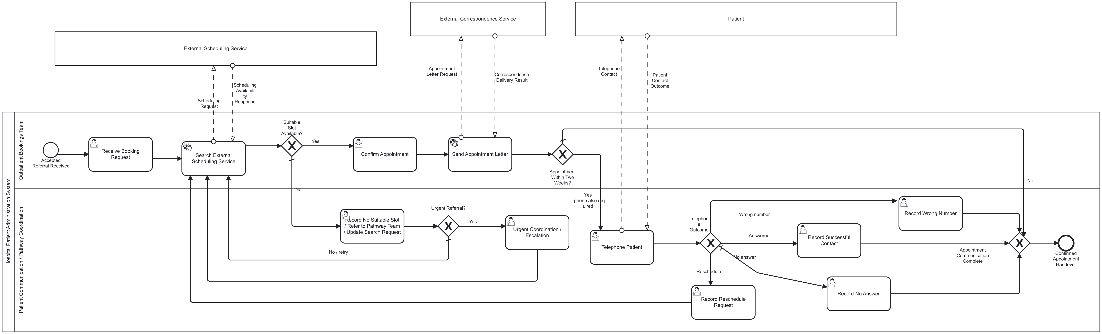
Operational BPMN: appointment and patient contact
WU JIA WEI / 05
Notes:
Presenter: WU JIA WEI
中文讲解与可能追问
预约表单提交后 search-appointment-slot 返回 slotAvailable 和 appointmentWithinTwoWeeks。没有号源会出现可编辑重试任务；有号源则确认并调用 send-appointment-letter。14 天内除了信件还需电话。电话结果 ANSWERED、NO_ANSWER、WRONG_NUMBER 记录后可交接；RESCHEDULE 回到搜索。可能追问：第十四天算不算两周内？worker 用 0 到 14 天含端点。
Sources
D:\Camunda-Workspace\models\assignment\bpmn\23084364_Appointment_Patient_Communication\BPMN\Appointment_Patient_Communication.bpmn
D:\Camunda-Workspace\models\assignment\bpmn\23084364_Appointment_Patient_Communication\Forms\Form_AppointmentBooking.form
D:\Camunda-Workspace\models\assignment\bpmn\23084364_Appointment_Patient_Communication\Forms\Form_PatientContact.form
D:\Camunda-Workspace\models\assignment\External_Workers\src\main\java\org\hospital\workers\AppointmentWorkers.java
Acceptance criteria are pass/fail targets. This deck does not claim that every criterion has passed in the final Camunda deployment.

Slide 6
Appointment: measurable acceptance criteria
ID | Given / when | Measurable pass condition
A1 | Omit each required booking field | patientId, speciality, priority and timeframe each block submission when empty (4/4).
A2 | Slot unavailable; edit request to available | First search returns slotAvailable=false and confirmed handover count=0. After editing, a second search runs and can reach confirmation.
A3 | Set appointment date to today+14 and today+15 | Day 14: telephone task reached once. Day 15: telephone task reached 0 times. Both cases send the appointment letter.
A4 | Choose each telephone outcome | RESCHEDULE starts a new search; ANSWERED, NO_ANSWER and WRONG_NUMBER each record outcome and reach handover (4/4 routes).
WU JIA WEI / 06
Notes:
Presenter: WU JIA WEI
中文讲解与可能追问
预约表单四个必填项已逐一读取；患者联系表单要求 contactOutcome。A2 要证明重试真的使用了修改后数据。A3 用执行当天的相对日期，不写死日历日期；目前现有 Java 测试没有第 14/15 天边界。当前模型允许无人接听和号码错误后交接，这是可测的既有行为，不应宣称必须成功联系。
Sources
D:\Camunda-Workspace\models\assignment\bpmn\23084364_Appointment_Patient_Communication\BPMN\Appointment_Patient_Communication.bpmn
D:\Camunda-Workspace\models\assignment\bpmn\23084364_Appointment_Patient_Communication\Forms\Form_AppointmentBooking.form
D:\Camunda-Workspace\models\assignment\bpmn\23084364_Appointment_Patient_Communication\Forms\Form_PatientContact.form
D:\Camunda-Workspace\models\assignment\External_Workers\src\main\java\org\hospital\workers\AppointmentWorkers.java
Acceptance criteria are pass/fail targets. This deck does not claim that every criterion has passed in the final Camunda deployment.

Slide 7
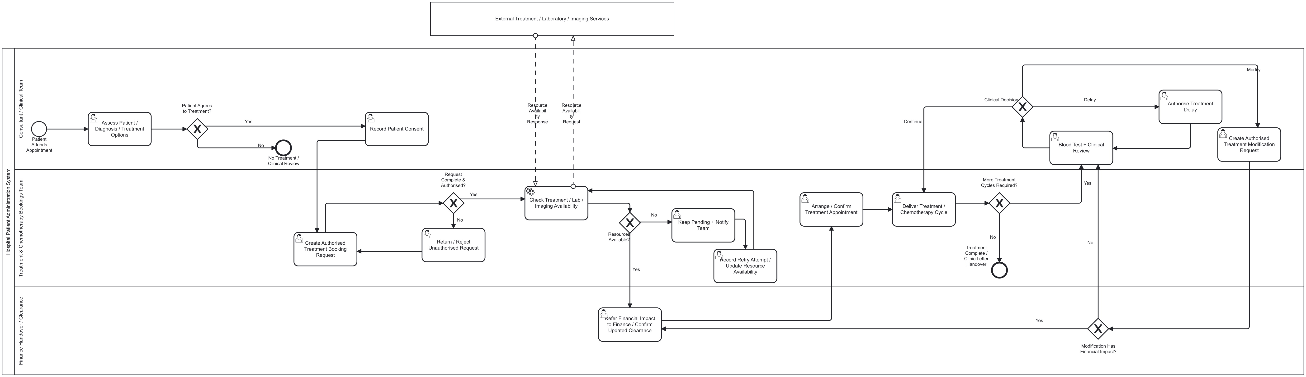
Operational BPMN: treatment and chemotherapy
LIN JIA QIANG / 07
Notes:
Presenter: LIN JIA QIANG
中文讲解与可能追问
治疗图依次区分患者同意、授权的治疗请求、资源可用性和后续周期。不同意治疗时子流程结束，但主流程仍触发信件。请求未授权返回更正。资源不足重新打开治疗请求表单。更多周期由 moreCycles 人工选择；CONTINUE、DELAY、MODIFY 各走不同路径。财务影响为 true 时进入人工确认更新清算，而非自动重新审批。
Sources
D:\Camunda-Workspace\models\assignment\bpmn\23084368_Treatment_Chemotherapy\BPMN\Treatment_Chemotherapy.bpmn
D:\Camunda-Workspace\models\assignment\bpmn\23084368_Treatment_Chemotherapy\Forms\Form_ClinicalAssessment.form
D:\Camunda-Workspace\models\assignment\bpmn\23084368_Treatment_Chemotherapy\Forms\Form_TreatmentRequest.form
D:\Camunda-Workspace\models\assignment\bpmn\23084368_Treatment_Chemotherapy\Forms\Form_TreatmentCycleReview.form
D:\Camunda-Workspace\models\assignment\External_Workers\src\main\java\org\hospital\workers\TreatmentWorkers.java
Acceptance criteria are pass/fail targets. This deck does not claim that every criterion has passed in the final Camunda deployment.

Slide 8
Treatment: measurable acceptance criteria
ID | Given / when | Measurable pass condition
T1 | patientConsent = false | Resource-check job calls=0 and treatment-delivery tasks=0; master starts clinic-letter child once.
T2 | patientConsent=true; treatmentAuthorised=false | Resource-check job calls=0 until authorisation becomes true; correction task is reached at least once.
T3 | Resource false, then true after editing the form | Before correction: delivery count=0 and retry form appears. After correction: resource check runs again and delivery is reached.
T4 | moreCycles=true; test CONTINUE, DELAY and MODIFY | Each decision takes its named route (3/3). MODIFY with financialImpact=true reaches manual finance-clearance task once.
LIN JIA QIANG / 08
Notes:
Presenter: LIN JIA QIANG
中文讲解与可能追问
临床评估表单要求 patientId 和 clinicalAssessment；治疗请求还要求治疗项目、起始日期、周期数及频率。周期数为文本，当前流程并不自动计数。T1–T4 必须看当前部署实例；现有组件测试仅验证部分资源输入输出。单独启动治疗子流程会绕过主流程先清算的前提，答辩时需说明。
Sources
D:\Camunda-Workspace\models\assignment\bpmn\23084368_Treatment_Chemotherapy\BPMN\Treatment_Chemotherapy.bpmn
D:\Camunda-Workspace\models\assignment\bpmn\23084368_Treatment_Chemotherapy\Forms\Form_ClinicalAssessment.form
D:\Camunda-Workspace\models\assignment\bpmn\23084368_Treatment_Chemotherapy\Forms\Form_TreatmentRequest.form
D:\Camunda-Workspace\models\assignment\bpmn\23084368_Treatment_Chemotherapy\Forms\Form_TreatmentCycleReview.form
D:\Camunda-Workspace\models\assignment\External_Workers\src\main\java\org\hospital\workers\TreatmentWorkers.java
Acceptance criteria are pass/fail targets. This deck does not claim that every criterion has passed in the final Camunda deployment.

Slide 9
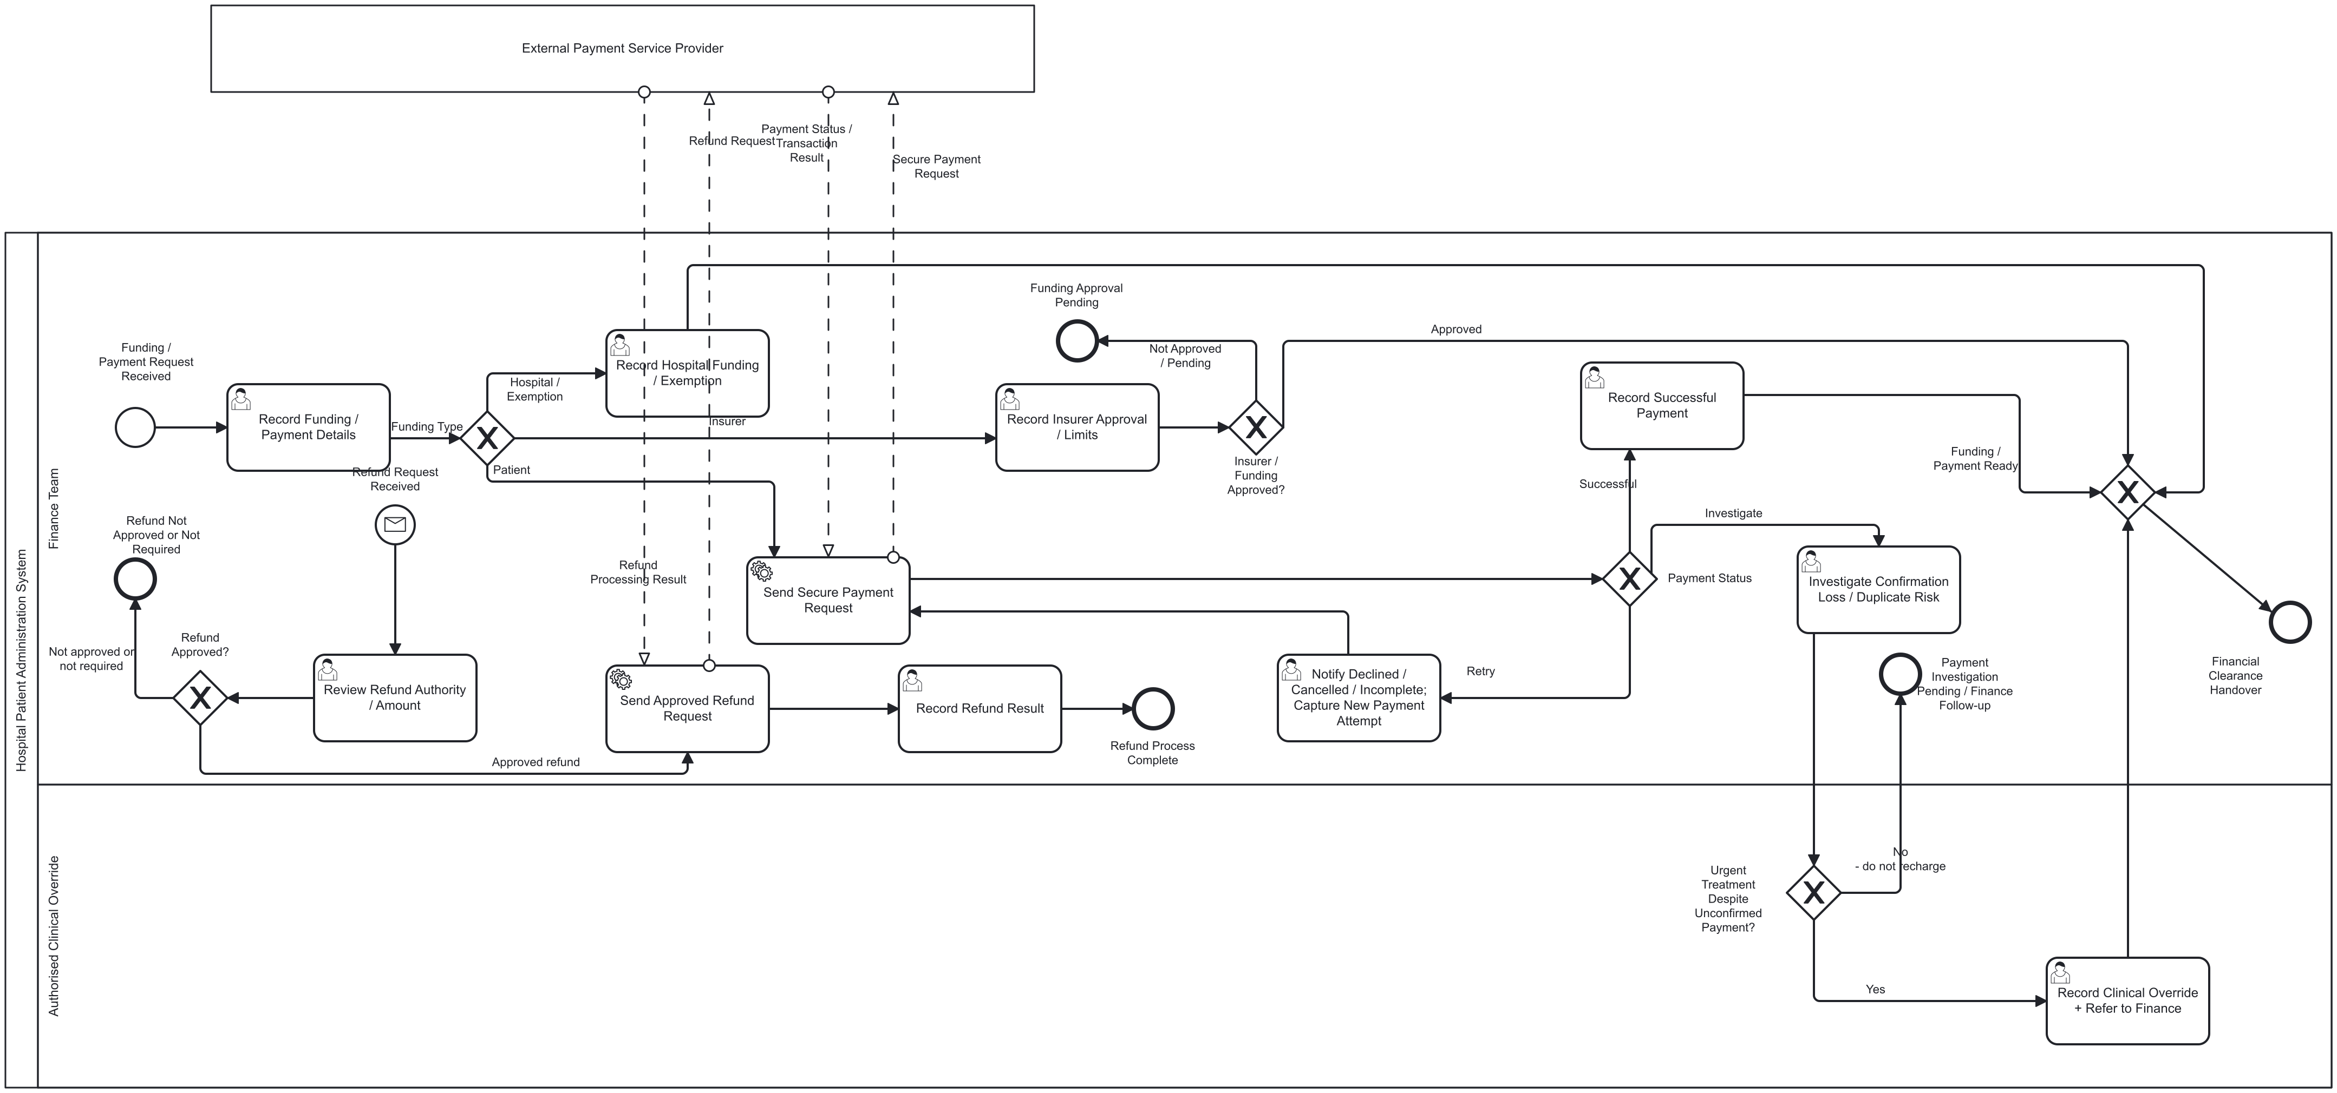
Operational BPMN: funding, payment and refund
WU TONG YU / 09
Notes:
Presenter: WU TONG YU
中文讲解与可能追问
资金路线有医院或减免、保险与患者付款。保险须记录是否批准。患者付款由 worker 返回 SUCCESSFUL、失败重试或待调查。CONFIRMATION_LOST 和 DUPLICATE_RISK 先调查，不自动再次扣款。退款从独立消息入口开始，refundRequired 与 refundApproved 同时为 true 才执行。可能追问：有没有真正防止重复扣款？目前没有持久化幂等键，只有风险分流。
Sources
D:\Camunda-Workspace\models\assignment\bpmn\23084362_Funding_Payment_Refund\BPMN\Funding_Payment_Refund.bpmn
D:\Camunda-Workspace\models\assignment\bpmn\23084362_Funding_Payment_Refund\Forms\Form_FundingPayment.form
D:\Camunda-Workspace\models\assignment\bpmn\23084362_Funding_Payment_Refund\Forms\Form_InsurerApproval.form
D:\Camunda-Workspace\models\assignment\bpmn\23084362_Funding_Payment_Refund\Forms\Form_RefundReview.form
D:\Camunda-Workspace\models\assignment\External_Workers\src\main\java\org\hospital\workers\FinanceWorkers.java
Acceptance criteria are pass/fail targets. This deck does not claim that every criterion has passed in the final Camunda deployment.

Slide 10
Finance: measurable acceptance criteria
ID | Given / when | Measurable pass condition
F1 | HOSPITAL / EXEMPTION / INSURER / PATIENT | All four funding values take their matching route (4/4); insurer approval=false gives clearance 0 times.
F2 | Patient payment SUCCESSFUL versus DECLINED | SUCCESSFUL reaches clearance once. DECLINED opens editable retry and reaches clearance 0 times before a successful attempt.
F3 | CONFIRMATION_LOST or DUPLICATE_RISK | Both results reach investigation (2/2); automatic second payment job calls=0 before a new authorised action.
F4 | Four refundRequired / refundApproved combinations | Refund worker is called only when both are true (1/4 combinations); the other 3 cases call it 0 times.
F5 | Lost confirmation, urgent override false versus true | False ends in pending follow-up. True records clinical override and permits clearance (2/2 routes).
WU TONG YU / 10
Notes:
Presenter: WU TONG YU
中文讲解与可能追问
资金表单要求 patientId 和 fundingType；保险表单要求 patientId 和 fundingOrganisation；退款表单要求 patientId。F3 的可量化标准是本流程在调查前不自动发起第二个 worker job，不能据此宣称支付系统有幂等保护。F4 是逻辑组合测试，真实退款服务仍为模拟。财务待处理是 end event，不是无限等待的挂起实例。
Sources
D:\Camunda-Workspace\models\assignment\bpmn\23084362_Funding_Payment_Refund\BPMN\Funding_Payment_Refund.bpmn
D:\Camunda-Workspace\models\assignment\bpmn\23084362_Funding_Payment_Refund\Forms\Form_FundingPayment.form
D:\Camunda-Workspace\models\assignment\bpmn\23084362_Funding_Payment_Refund\Forms\Form_InsurerApproval.form
D:\Camunda-Workspace\models\assignment\bpmn\23084362_Funding_Payment_Refund\Forms\Form_RefundReview.form
D:\Camunda-Workspace\models\assignment\External_Workers\src\main\java\org\hospital\workers\FinanceWorkers.java
Acceptance criteria are pass/fail targets. This deck does not claim that every criterion has passed in the final Camunda deployment.

Slide 11
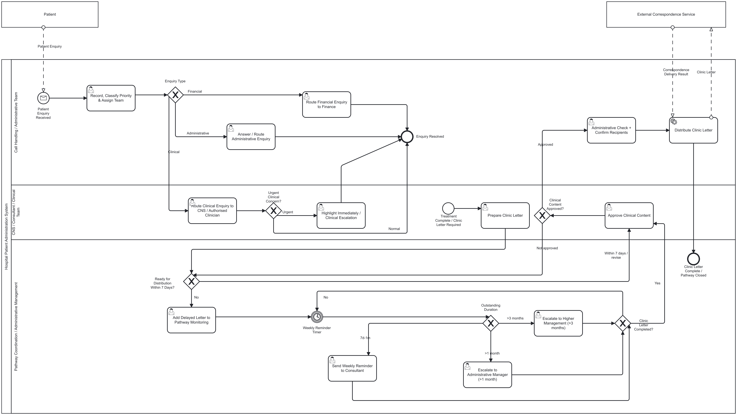
Operational BPMN: enquiry and clinic letter
XIAO YU YING / 11
Notes:
Presenter: XIAO YU YING
中文讲解与可能追问
这张运营图含两个入口。患者咨询从消息启动，按 ADMINISTRATIVE、FINANCIAL、CLINICAL 路由，临床紧急问题由 urgentClinicalConcern 额外升级。普通主流程进入信件准备；临床批准后才核对收件人和发送。延误支路有 P7D 定时器，再按人工选择的年龄段提醒顾问或升级。可能追问七天目标是否自动保证：没有；初始七天状态和年龄段由人填写，而且主流程在治疗结束后才启动信件。
Sources
D:\Camunda-Workspace\models\assignment\bpmn\24000813_Enquiry_ClinicLetter_Monitoring\BPMN\Enquiry_ClinicLetter_Monitoring.bpmn
D:\Camunda-Workspace\models\assignment\bpmn\24000813_Enquiry_ClinicLetter_Monitoring\Forms\Form_Enquiry.form
D:\Camunda-Workspace\models\assignment\bpmn\24000813_Enquiry_ClinicLetter_Monitoring\Forms\Form_ClinicLetter.form
D:\Camunda-Workspace\models\assignment\bpmn\24000813_Enquiry_ClinicLetter_Monitoring\Forms\Form_ClinicLetterApproval.form
D:\Camunda-Workspace\models\assignment\bpmn\24000813_Enquiry_ClinicLetter_Monitoring\Forms\Form_ClinicLetterMonitoring.form
D:\Camunda-Workspace\models\assignment\External_Workers\src\main\java\org\hospital\workers\EnquiryClinicLetterWorkers.java
Acceptance criteria are pass/fail targets. This deck does not claim that every criterion has passed in the final Camunda deployment.

Slide 12
Enquiry and clinic letter: measurable acceptance criteria
ID | Given / when | Measurable pass condition
L1 | Submit all three enquiryType options; urgent clinical=true | ADMINISTRATIVE / FINANCIAL / CLINICAL reach their named team (3/3); urgent clinical additionally reaches escalation once.
L2 | clinicLetterApproved=false, then true | False: send job calls=0. True: send job calls=1 and clinicLetterSent=true after recipient check.
L3 | Letter delayed; test three letterAgeBand options after P7D | 7D_TO_1M reminds consultant; OVER_1M escalates to admin manager; OVER_3M escalates higher (3/3).
L4 | For each consultation, compare sent time with consultation time | Target: sent time <= consultation time + 7 days. Current model has no automatic consultation-based clock, so this remains open.
XIAO YU YING / 12
Notes:
Presenter: XIAO YU YING
中文讲解与可能追问
咨询表单要求 patientId、enquiryType、enquiryPriority 和 enquiryDetails。信件准备要求临床内容、随访及收件人；监控表单要求 letterAgeBand。L1–L3 可用实例路径与变量判断，但 P7D 应真实等待或使用可审计的测试时钟。L4 是案例的可量化目标，当前模型无法自动计算，不应标成已通过。审批拒绝后当前流程没有明确返回可编辑正文任务，也可能被问到。
Sources
D:\Camunda-Workspace\models\assignment\bpmn\24000813_Enquiry_ClinicLetter_Monitoring\BPMN\Enquiry_ClinicLetter_Monitoring.bpmn
D:\Camunda-Workspace\models\assignment\bpmn\24000813_Enquiry_ClinicLetter_Monitoring\Forms\Form_Enquiry.form
D:\Camunda-Workspace\models\assignment\bpmn\24000813_Enquiry_ClinicLetter_Monitoring\Forms\Form_ClinicLetter.form
D:\Camunda-Workspace\models\assignment\bpmn\24000813_Enquiry_ClinicLetter_Monitoring\Forms\Form_ClinicLetterApproval.form
D:\Camunda-Workspace\models\assignment\bpmn\24000813_Enquiry_ClinicLetter_Monitoring\Forms\Form_ClinicLetterMonitoring.form
D:\Camunda-Workspace\models\assignment\External_Workers\src\main\java\org\hospital\workers\EnquiryClinicLetterWorkers.java
Acceptance criteria are pass/fail targets. This deck does not claim that every criterion has passed in the final Camunda deployment.

